Slide 1

Institution of Technology
School of Computing
Department of Information Technology , CS and SE
Introduction to Distributed System
Chapter 6 - Consistency and Replication
January 3/ 2025
Dawit A

Slide 2
Chapter 7 - Consistency and Replication

Slide 3
Objectives of the Chapter
we discuss
why replication is useful and its relation with scalability; in particular object-based replication
consistency models
Data –Centric consistency Model
client–centric consistency models
how consistency and replication are implemented

Slide 4
6.1 Reasons for Replication
two major reasons: reliability and performance
reliability
if a file is replicated, we can switch to other replicas if there is a crash on our replica
we can provide better protection against corrupted data; similar to mirroring in non-distributed systems
performance
if the system has to scale in size and geographical area
place a copy of data in the proximity of the process using them, reducing the time of access and increasing its performance; for example a Web server is accessed by thousands of clients from all over the world

Slide 5
Replication as Scaling Technique
replication and caching are widely applied as scaling techniques
processes can use local copies and limit access time and traffic
however, we need to keep the copies consistent; but this may requires more network bandwidth
if the copies are refreshed more often than used (low access-to-update ratio), the cost (bandwidth) is more expensive than the benefits;
Dilemma( tradeoff)
scalability problems can be alleviated by applying replication and caching, leading to a better performance
but, keeping copies consistent requires global synchronization, which is generally costly in terms of performance
solution: loosen the consistency constraints
updates do not need to be executed as atomic operations (no more instantaneous global synchronization); but copies may not be always the same everywhere
to what extent the consistency can be loosened depends on the specific application (the purpose of data as well as access and update patterns)

Slide 6
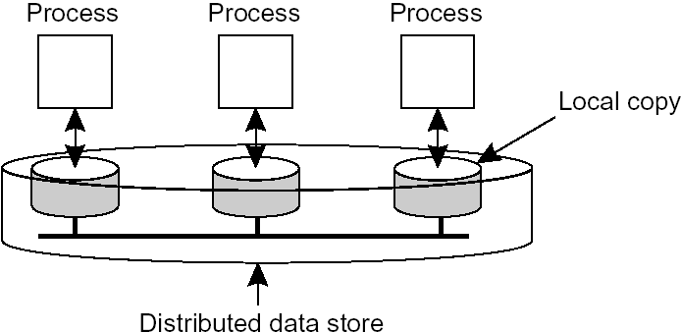
6.2 Data-Centric Consistency Models
consistency has always been discussed
in terms of read and write operations on shared data available by means of (distributed) shared memory, a (distributed) shared database, or a (distributed) file system
we use the broader term data store, which may be physically distributed across multiple machines
assume also that each process has a local copy of the data store and write operations are propagated to the other copies
the general organization of a logical data store, physically distributed and replicated across multiple processes

Slide 7
a consistency model is a contract between processes and the data store
processes agree to obey certain rules
then the data store promises to work correctly
ideally, a process that reads a data item expects a value that shows the results of the last write operation on the data
in a distributed system and in the absence of a global clock and with several copies, it is difficult to know which is the last write operation
to simplify the implementation, each consistency model restricts what read operations return
data-centric consistency models to be discussed
strict consistency
sequential consistency
causal consistency
weak consistency
release consistency
entry consistency

Slide 8
1. Strict Consistency
the most stringent consistency model and is defined by the following condition:
Any read on a data item x returns a value corresponding to the result of the most recent write on x.
the following notations and assumptions will be used
W_{i}(x)_{a} means write by P_{i} to data item x with the value a has been done
R_{i}(x)_{b} means a read by P_{i} to data item x returning the value b has been done
Assume that initially each data item is NIL
consider the following example; write operations are done locally and later propagated to other replicas
behavior of two processes operating on the same data item
a strictly consistent data store
a data store that is not strictly consistent; P2’s first read may be, for example, after 1 nanosecond of P1’s write
the solution is to relax absolute time and consider time intervals

Slide 9
2. Sequential Consistency
strict consistency is the ideal but impossible to implement
fortunately, most programs do not need strict consistency
sequential consistency is a slightly weaker consistency
a data store is said to be sequentially consistent when it satisfies the following condition:
The result of any execution is the same as if the (read and write) operations by all processes on the data store were executed in some sequential order and the operations of each individual process appear in this sequence in the order specified by its program
i.e., all processes see the same interleaving of operations
time does not play a role; no reference to the “most recent” write operation

Slide 10


example: four processes operating on the same data item x
the write operation of P2 appears to have taken place before that of P1; but for all processes
a sequentially consistent data store
to P3, it appears as if the data item has first been changed to b, and later to a; but P4 , will conclude that the final value is b
not all processes see the same interleaving of write operations
a data store that is not sequentially consistent

Slide 11
3. Weak Consistency
there is no need to worry about intermediate results in a critical section since other processes will not see the data until it leaves the critical section; only the final result need to be seen by other processes
this can be done by a synchronization variable, S, that has only a single associated operation synchronize(S), which synchronizes all local copies of the data store
a process performs operations only on its locally available copy of the store
when the data store is synchronized, all local writes by process P are propagated to the other copies and writes by other processes are brought in to P’s copy

Slide 12
this leads to weak consistency models which have three properties
Accesses to synchronization variables associated with a data store are sequentially consistent (all processes see all operations on synchronization variables in the same order)
No operation on a synchronization variable is allowed to be performed until all previous writes have been completed everywhere
No read or write operation on data items are allowed to be performed until all previous operations to synchronization variables have been performed.All previous synchronization will have been completed; by doing a synchronization a process can be sure of getting the most recent values)

Slide 13

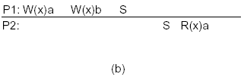
weak consistency enforces consistency on a group of operations, not on individual reads and writes
e.g., S stands for synchronizes; it means that a local copy of a data store is brought up to date
a valid sequence of events for weak consistency
an invalid sequence for weak consistency; P2 should get b

Slide 14
4. Release Consistency
with weak consistency model, when a synchronization variable is accessed, the data store does not know whether it is done because the process has finished writing the shared data or is about to start reading
if we can separate the two (entering a critical section and leaving it), a more efficient implementation might be possible
the idea is to selectively guard shared data; the shared data that are kept consistent are said to be protected
release consistency provides mechanisms to separate the two kinds of operations or synchronization variables
an acquire operation is used to tell that a critical region is about to be entered
a release operation is used to tell that a critical region has just been exited

Slide 15

when a process does an acquire, the store will ensure that all copies of the protected data are brought up to date to be consistent with the remote ones; does not guarantee that locally made changes will be sent to other local copies immediately
when a release is done, protected data that have been changed are propagated out to other local copies of the store; it does not necessarily import changes from other copies
a valid event sequence for release consistency
a distributed data store is release consistent if it obeys the following:
Before a read or write operation on shared data is performed, all previous acquires done by the process must have completed successfully.
Before a release is allowed to be performed, all previous reads and writes by the process must have been completed.

Slide 16
implementation algorithm :
Eager release consistency
to do an acquire, a process sends a message to a central synchronization manager requesting an acquire on a particular lock
if there is no competition, the request is granted
then, the process does reads and writes on the shared data, locally
when the release is done, the modified data are sent to the other copies that use them
after each copy has acknowledged receipt of the data, the synchronization manager is informed of the release
ii.Lazy release consistency
at the time of release, nothing is sent anywhere
instead, when an acquire is done, the process trying to do an acquire has to get the most recent values of the data
this avoids sending values to processes that don’t need them thereby reducing wastage of bandwidth

Slide 17
6.3 Client-Centric Consistency Models
with many applications, updates happen very rarely
for these applications, data-centric models where high importance is given for updates are not suitable
Eventual Consistency
there are many applications where few processes (or a single process) update the data while many read it and there are no write-write conflicts; we need to handle only read-write conflicts; e.g., DNS server, Web site
for such applications, it is even acceptable for readers to see old versions of the data (e.g., cached versions of a Web page) until the new version is propagated
with eventual consistency, it is only required that updates are guaranteed to gradually propagate to all replicas
the problem with eventual consistency is when different replicas are accessed, e.g., a mobile client accessing a distributed database may acquire an older version of data when it uses a new replica as a result of changing location

Slide 18
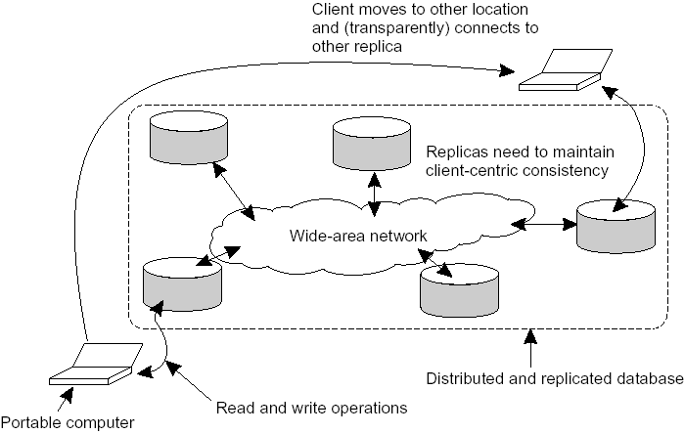
the principle of a mobile user accessing different replicas of a distributed database
the solution is to introduce client-centric consistency
it provides guarantees for a single client concerning the consistency of accesses to a data store by that client; no guaranties are given concerning concurrent accesses by different clients

Slide 19
1. Monotonic Reads
a data store is said to provide monotonic-read consistency if the following condition holds:
If a process reads the value of a data item x, any successive read operation on x by that process will always return that same value or a more recent value
i.e., a process never sees a version of data older than what it has already seen
Writes Follow Reads
a data store is said to provide writes-follow-reads consistency, if:
A write operation by a process on a data item x following a previous read operation on x by the same process, is guaranteed to take place on the same or a more recent value of x that was read
i.e., any successive write operation by a process on a data item x will be performed on a copy of x that is up to date with the value most recently read by that process
this guaranties, for example, that users of a newsgroup see a posting of a reaction to an article only after they have seen the original article; if B is a response to message A, writes-follow-reads consistency guarantees that B will be written to any copy only after A has been written

Slide 20
6.4 Distribution Protocols
there are different ways of propagating, i.e., distributing updates to replicas, independent of the consistency model
we will discuss
replica placement
update propagation
epidemic protocols
Replica Placement
a major design issue for distributed data stores is deciding where, when, and by whom copies of the data store are to be placed
three types of copies:
permanent replicas
server-initiated replicas
client-initiated replicas

Slide 21
Permanent Replicas
the initial set of replicas that constitute a distributed data store; normally a small number of replicas
e.g., a Web site: two forms
the files that constitute a site are replicated across a limited number of servers on a LAN; a request is forwarded to one of the servers
mirroring: a Web site is copied to a limited number of servers, called mirror sites, which are geographically spread across the Internet; clients choose one of the mirror sites
Server-Initiated Replicas (push caches)
Web Hosting companies dynamically create replicas to improve performance (e.g., create a replica near hosts that use the Web site very often)
Client-Initiated Replicas (client caches or simply caches)
to improve access time
a cache is a local storage facility used by a client to temporarily store a copy of the data it has just received
managing the cache is left entirely to the client; the data store from which the data have been fetched has nothing to do with keeping cached data consistent

Slide 22
Update Propagation
updates are initiated at a client, forwarded to one of the copies, and propagated to the replicas ensuring consistency
some design issues in propagating updates
state versus operations
pull versus push protocols
unicasting versus multicasting
State versus Operations
what is actually to be propagated? three possibilities
send notification of update only (for invalidation protocols - useful when read/write ratio is small); use of little bandwidth
transfer the modified data (useful when read/write ratio is high)
transfer the update operation (also called active replication); it assumes that each machine knows how to do the operation; use of little bandwidth, but more processing power needed from each replica

Slide 23
Pull versus Push Protocols
push-based approach (also called server- based protocols): propagate updates to other replicas without those replicas even asking for the updates (used when high degree of consistency is required and there is a high read/write ratio)
pull-based approach (also called client-based protocols): often used by client caches; a client or a server requests for updates from the server whenever needed (used when the read/write ratio is low)
a comparison between push-based and pull-based protocols; for simplicity assume multiple clients and a single server

Slide 24
Unicasting versus Multicasting
multicasting can be combined with push-based approach; the underlying network takes care of sending a message to multiple receivers
unicasting is the only possibility for pull-based approach; the server sends separate messages to each receiver
Epidemic Protocols
update propagation in eventual consistency is often implemented by a class of algorithms known as epidemic protocols
updates are aggregated into a single message and then exchanged between two servers

Slide 25
6.5 Consistency Protocols
so far we have concentrated on various consistency models and general design issues
consistency protocols describe an implementation of a specific consistency model
there are three types
primary-based protocols
remote-write protocols
local-write protocols
replicated-write protocols
active replication
quorum-based protocols
cache-coherence protocols

Slide 26
1. Primary-Based Protocols
each data item x in the data store has an associated primary, which is responsible for coordinating write operations on x
two approaches: remote-write protocols, and local-write protocols
a. Remote-Write Protocols
all read and write operations are carried out at a (remote) single server; in effect, data are not replicated; traditionally used in client-server systems, where the server may possibly be distributed

Slide 27
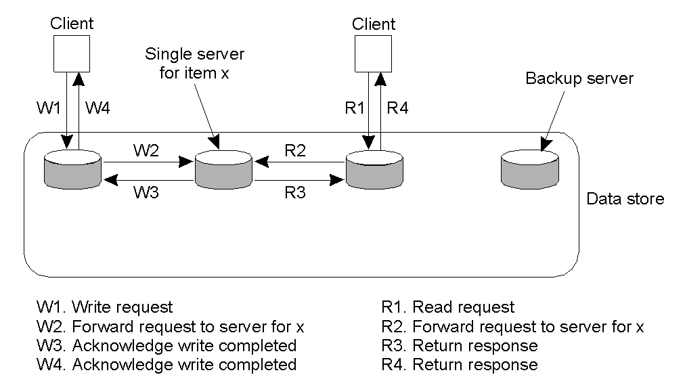
primary-based remote-write protocol with a fixed server to which all read and write operations are forwarded

Slide 28
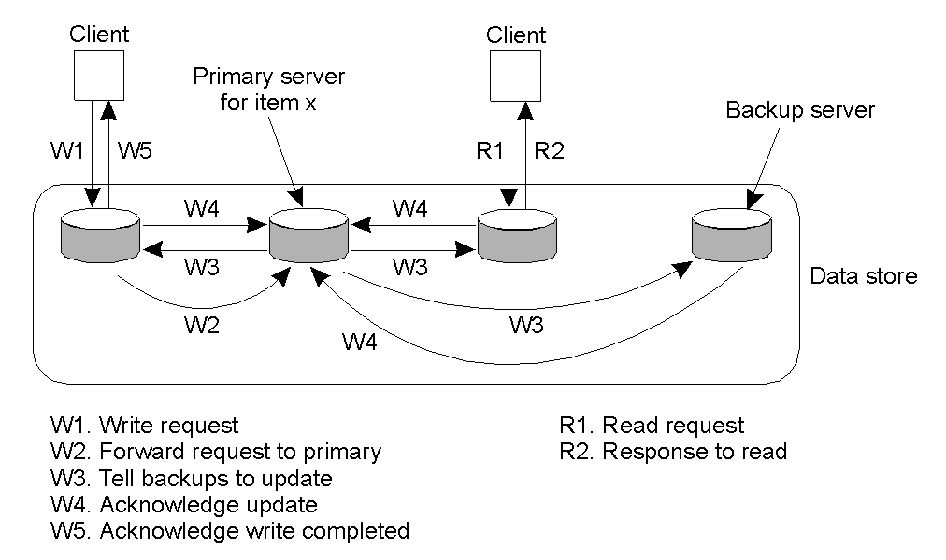
another approach is primary-backup protocols where reads can be made from local backup servers while writes should be made directly on the primary server
the backup servers are updated each time the primary is updated
the principle of primary-backup protocol

Slide 29
may lead to performance problems since it may take time before the process that initiated the write operation is allowed to continue - updates are blocking
primary-backup protocols provide straightforward implementation of sequential consistency; the primary can order all incoming writes
b. Local-Write Protocols
two approaches
i. there is a single copy; no replicas
when a process wants to perform an operation on some data item, the single copy of the data item is transferred to the process, after which the operation is performed

Slide 30
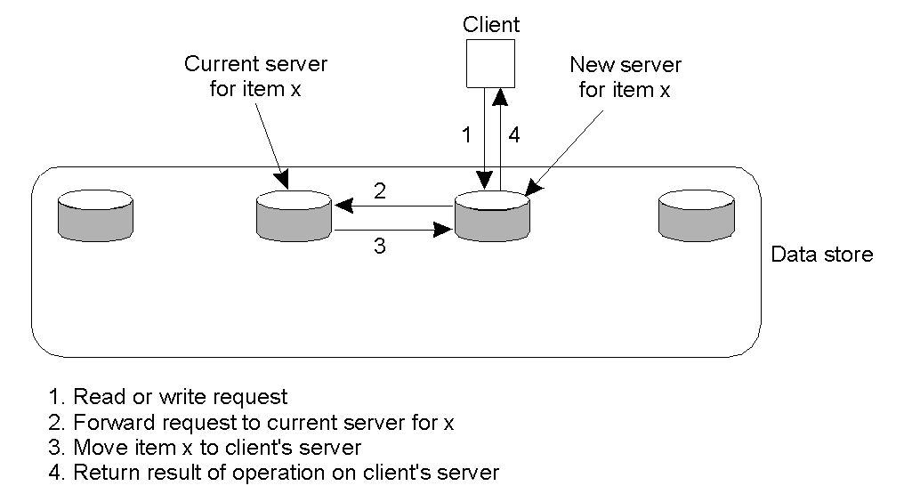
primary-based local-write protocol in which a single copy is migrated between processes
consistency is straight forward
keeping track of the current location of each data item is a major problem

Slide 31
ii. primary-backup local-write protocol
the primary migrates between processes that wish to perform a write operation
multiple, successive write operations can be carried out locally, while (other) reading processes can still access their local copy
such improvement is possible only if a nonblocking protocol is followed

Slide 32
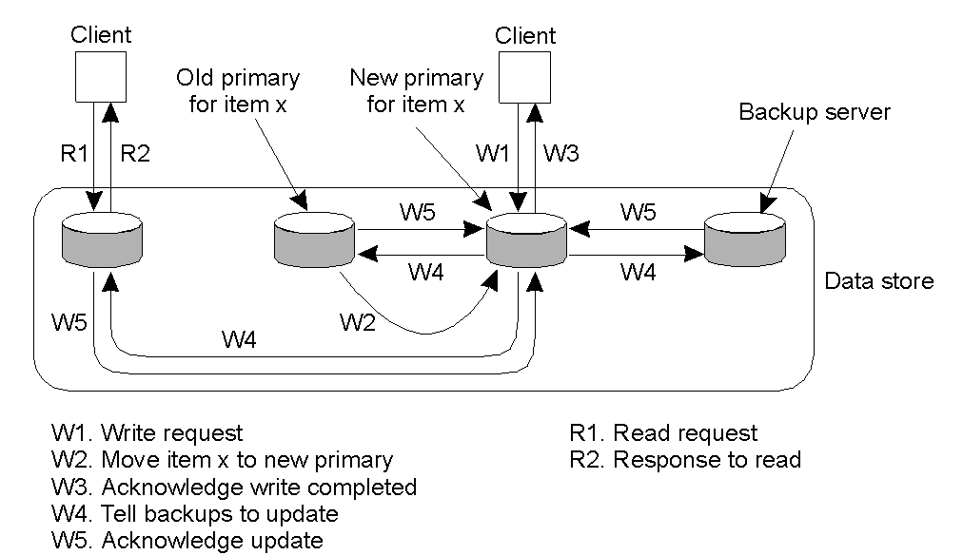
primary-backup protocol in which the primary migrates to the process wanting to perform an update

Slide 33
2.Replicated-Write Protocols
unlike primary-based protocols, write operations can be carried out at multiple replicas; two approaches: Active Replication and Quorum-Based Protocols
a. Active Replication
each replica has an associated process that carries out update operations
updates are generally propagated by means of write operations (the operation is propagated); also possible to send the update
the operations need to be done in the same order everywhere; totally-ordered multicast
two possibilities to ensure that the order is followed
Lamport’s timestamps, or
use of a central sequencer that assigns a unique sequence number for each operation; the operation is first sent to the sequencer then the sequencer forwards the operation to all replicas

Slide 34
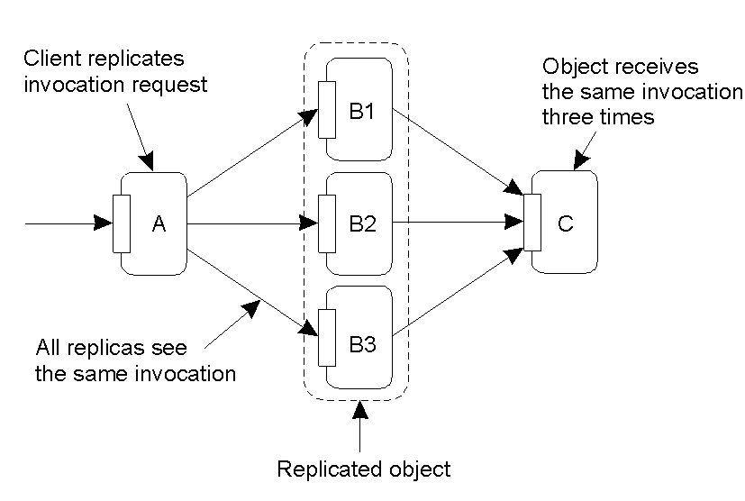
a problem is replicated invocations
suppose object A invokes B, and B invokes C; if object B is replicated, each replica of B will invoke C independently
this may create inconsistency and other effects; what if the operation on C is to transfer $10
the problem of replicated invocations

Slide 35
one solution is to have a replication-aware communication layer that avoids the same invocation being sent more than once
when a replicated object B invokes another replicated object C, the invocation request is first assigned the same, unique identifier by each replica of B
a coordinator of the replicas of B forwards its request to all replicas of object C; the other replicas of object B hold back; hence only a single request is sent to each replica of C
the same mechanism is used to ensure that only a single reply message is returned to the replicas of B

Slide 36
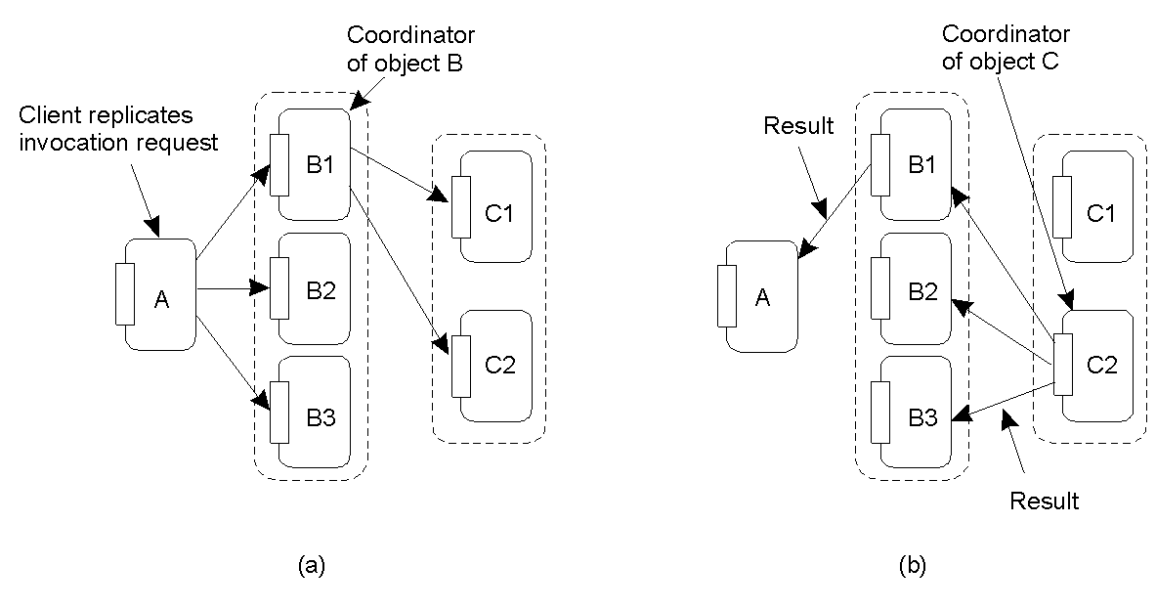
forwarding an invocation request from a replicated object
returning a reply to a replicated object

Slide 37
3. Cache-Coherence Protocols
cashes form a special case of replication as they are controlled by clients instead of servers
cache-coherence protocols ensure that a cache is consistent with the server-initiated replicas
two design issues in implementing caches: coherence detection and coherence enforcement
coherence detection strategy: when inconsistencies are actually detected
static solution: prior to execution, a compiler performs the analysis to determine which data may lead to inconsistencies if cached and inserts instructions that avoid inconsistencies
dynamic solution: at runtime, a check is made with the server to see whether a cached data have been modified since they were cached

Slide 38
coherence enforcement strategy: how caches are kept consistent with the copies stored at the servers
simplest solution: do not allow shared data to be cached; suffers from performance improvement
allow caching shared data and
let a server send an invalidation to all caches whenever a data item is modified
or
propagate the update

